Slide 1
District 6110 Grant Management Seminar
Foundation Overview – Ed Hardesty, District 6110 Foundation Chair
Global Grants – Beth Keck, District 6110 Global Grant Chair
District Grants – Cathy Webster, ARRFC, District Grant Chair
DACdb Process – Rachelle Langley & Cathy Webster
Questions and Answers – All
Closing Remarks – Warren Lovinger, District Governor Elect
Notes:
Direct funding using Club
Increase leverage of club funds:
3-1 match district grant
TRF Global Grants w/ 80% Global Fund match

Slide 2
Foundation Overview – Funding Model
Annual Fund
Endowment Fund
Restricted Gifts
Notes:
Direct funding using Club
Increase leverage of club funds:
3-1 match district grant
TRF Global Grants w/ 80% Global Fund match

Slide 3
Funds Available – 2021 – 2022 Annual Fund SHARE Giving $375,804 Total Annual Fund Giving $424,774
47.5% Share to World Fund - $178,507
47.5% Share to District Designated Fund - $178,507
$89,253 (plus Endowment Fund Earnings) Available for District Grants
$36,000 Polio Donation
$53,254 Available for Global Grants, Plus Carryover
Notes:
Direct funding using Club
Increase leverage of club funds:
3-1 match district grant
TRF Global Grants w/ 80% Global Fund match

Slide 4
Qualifying for Rotary Foundation Grants
Attend this Grant Management Seminar
Current Club President and President-Elect Sign Memorandum of Understanding
Send signed MOU to Rotary District 6110 Office
Notes:
Direct funding using Club
Increase leverage of club funds:
3-1 match district grant
TRF Global Grants w/ 80% Global Fund match

Slide 5
Pathways for International Service
Club and Individually Funded Projects
Sometimes leveraged with District Grants or TRF Global Grants
District Grants
Smaller scale, short duration addressing immediate needs
The Rotary Foundation Global Grants
Minimum: $30,000, Maximum $400,000
Potential for 80% match from TRF Global Fund
Notes:
Direct funding using Club
Increase leverage of club funds:
3-1 match district grant
TRF Global Grants w/ 80% Global Fund match

Slide 6
Humanitarian projects
Scholarships for graduate-level academic studies
Vocational training teams
July 2020-June 2021
Fiscal Year ending 6/30/2023
https://www.rotary.org/en/annual-report-2021/finances
Notes:
Rotary Program Year 2022: $330M donations; $73M to Global Grants

Slide 7
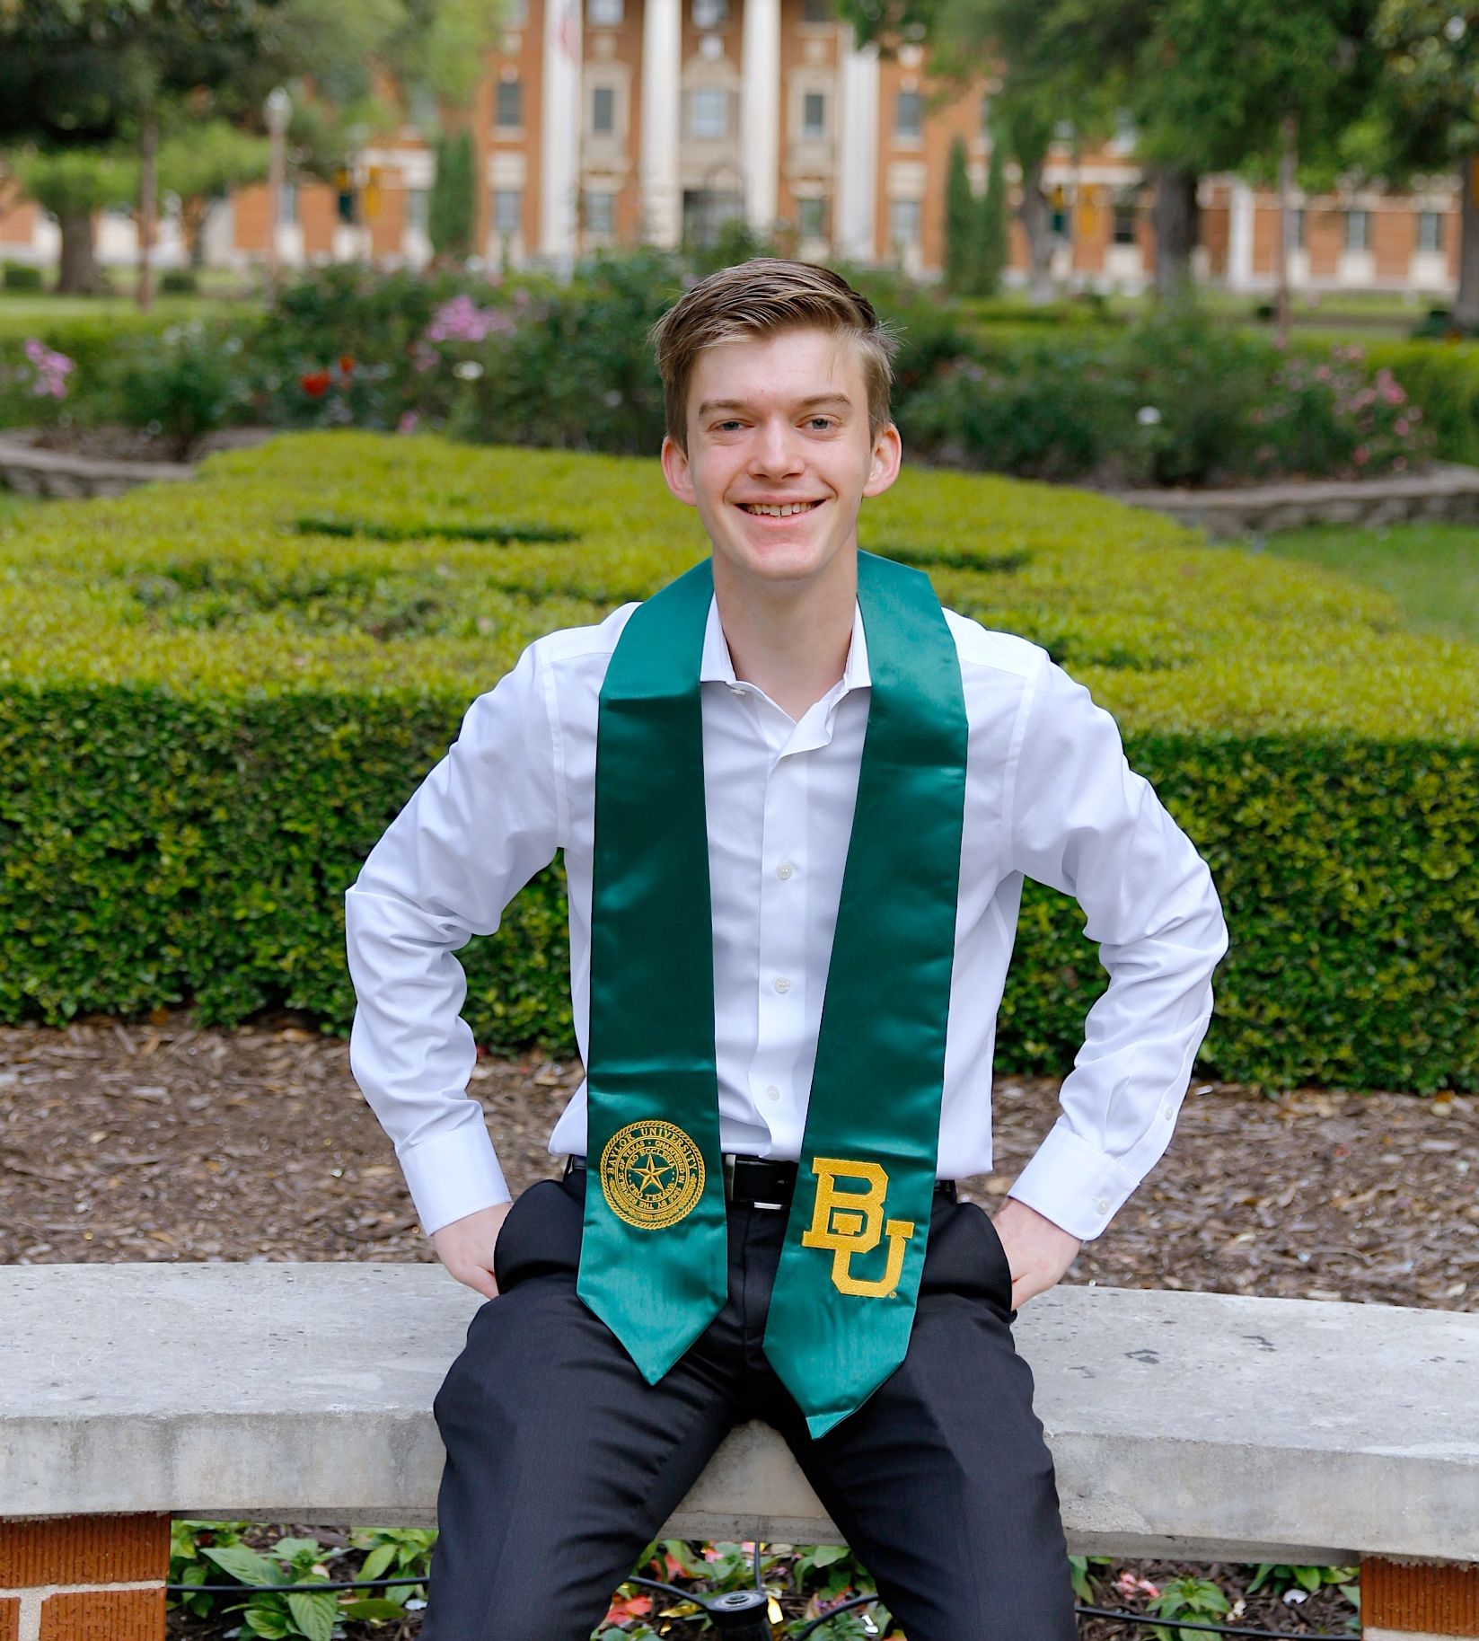
Scholarship Recipient Ty Rossow
Community and Economic Development Area of Focus
University of Cambridge
1-Year Master’s Degree

Slide 8
2022-2023 Program Year
2021-22 Program Year
2021-22 Program Year

Slide 9
Global Grants Leverage Local Funds
D6110 DDF $30,000
TRF World Fund Match $24,000
Global Grant $54,000
Annual Fund Share Donations

Slide 10
Global Grant Facts
Project Budget:
$30,000 - $400,000
Project Funding
80% World Fund match for DDF contributions
District Designated Funds (DDF)
Donations from clubs and individuals
Sponsorship
Host district or club in country where project occurs
International district or club partner
Key Requirements:
Rotary Area of Focus
Community Assessment
Sustainability
Notes:
Global Grant Requirements:
$30k – 200K budget
80% match from TRF World Fund – replenished by our donations to Annual Fund Share
Must have international club or district
Community assessment
Plan to sustain the project
Online application form on Rotary website – happy to help

Slide 11
District 6110 Points of Contact
The Rotary Foundation
Ed Hardesty, Rotary Club of Tulsa Southeast
Tel: 918-706-5730; email: edwinh1313@me.com
District Grants
Cathy Webster, Rotary Club of Pryor
Tel: 918-6265720; email: cathywebster6110@gmail.com
Notes:
Please contact Ed or me

Slide 12
District 6110 Points of Contact
Global Grants
Beth Keck, Rotary Club of Bentonville
Tel: 479-366-3068; email: bethkeck719@gmail.com
International Service
Lisa Engel, Rotary Club of Broken Arrow
Tel: 918-409-4282; email: tigertowntees@yahoo.com
DACdb
Rachelle Langley, Rotary Club of North Tulsa
Tel: 918-350-8379; email: Rachelle.Langley@memberminderpro.com
Notes:
Please contact Ed or me

Slide 13
District 6110 Grant Management Seminar
Questions and Answers
Notes:
Direct funding using Club
Increase leverage of club funds:
3-1 match district grant
TRF Global Grants w/ 80% Global Fund match

